Slide 1


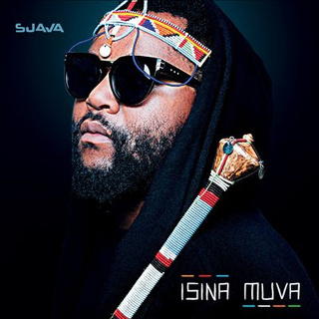
...
Now Playing
The Band
Song
Information
...
.
Seven
.
by
Sjava
73%
Active

